Slide 1



Full Stack Engineering Community Cognizant Digital Engineering

Slide 2



The Future of Application Development
CNA
Cloud-Native
Applications
Microservices
Decoupled
Continuous Delivery
App Transformation
Decompose Monolithic Apps
Innovation
Continuously Innovate
DevOps
XP, Lean Startup, Agile
Experts enable enterprises to move at the speed of business
Directly solve real business problems
Combining Agile and DevOps to achieve amazing results
2
Notes:
To summarize, here are the trends in application development.

Slide 3










Cognizant Digital Engineering embraces future with
NEW THINKING
That imbibes cultural changes
NEW ENGINEERING
That inculcates new age practices
NEW TECHNOLOGY
That simplifies, standardizes and automates
Human
Centricity
Value
Centricity
DevOps/
TDD/ CI/ CD
MVP/
Rapid Prototyping
Cloud Native
Services (PaaS)
Micro-services
Architectures
|>|
+₊
Lean
Startup
Incremental
Innovation
Agile/
XP
Low Code
Development
API Driven/
Open Standards
Automation
Tools
Notes:
While www meant world wide web, around 2 decades back, the new 3Ws represent modern ways of working needed for Digital -which is newer ways of work, workplace and workforce.
The way we operate is centered around 3Ws.
Work: This is about the type of work we do that involves new thinking, new engineering and new technology.

Slide 4

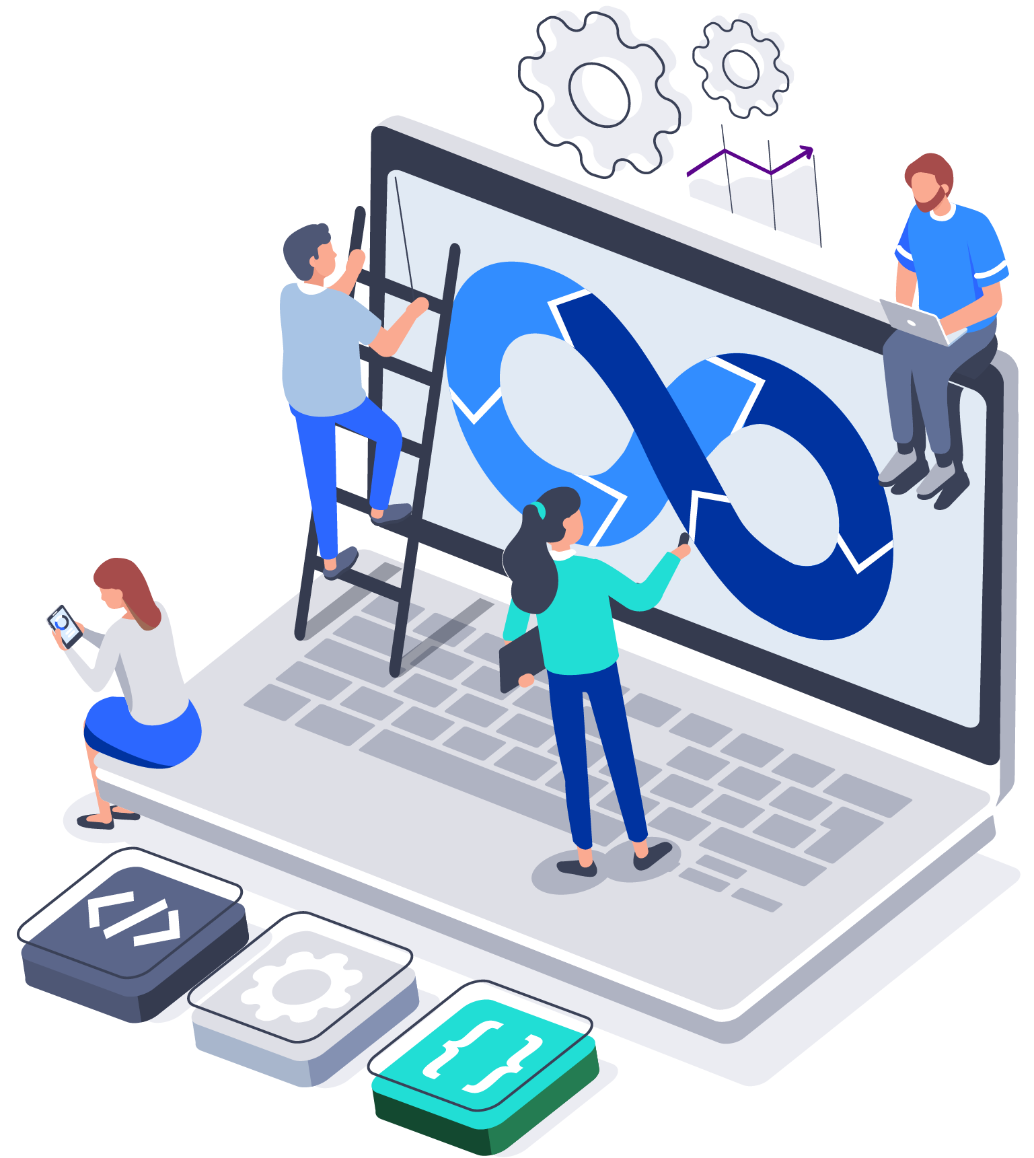


What are Communities?
People-centric organizations that grow the talent we need to create greater impact for our clients, today and in the future
Our associates’ primary group of belonging
Hubs of like-minded, expert talent with similar career goals and aspirations

Slide 5








Building a Modern Digital Engineering culture through CDE Communities
Cognizant Digital Engineering has built a strong foundation and taken the significant step in establishing capabilities-based community model.
Communities-based model gives an incredibly exciting opportunity to build a modern digital engineering culture, with more exposure to leading-edge technologies and methodologies.
The chance to work alongside like-minded professionals and help our clients prosper in the digital era will create organic opportunities to learn, sharpen, and expand our skills.
Each of our communities has been growing, evolving, and solidifying its respective missions to deliver unique value propositions to clients
Engineering
Management
Full Stack
Engineering
Product
Management
Digital
Architecture
Resilience and
Reliability (R2)
Engineering™
Agile
DevOps
Blockchain

Slide 6
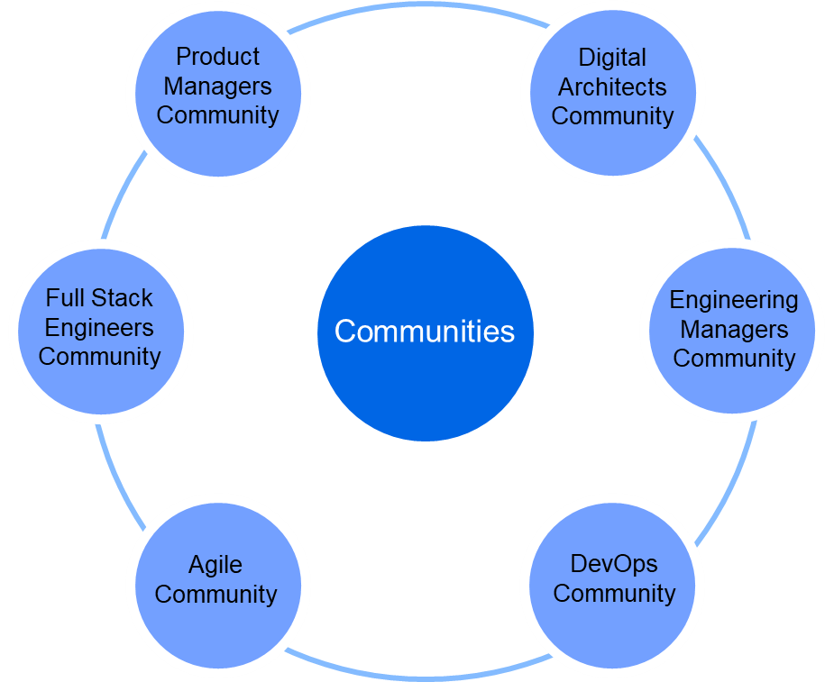
Integrated Modern Talent & Modern Engineering = Continuous Outcomes From Project Hierarchies to Capability based Communities
Enhance Engineering Outcomes
Nurture & Grow Talent
Instill a sense of belonging
Drive engineering culture
The best people are brought together to engineer beautiful software; Nurtured and mentored in ‘Communities’.

Slide 7
Full Stack Engineering Community

Slide 8
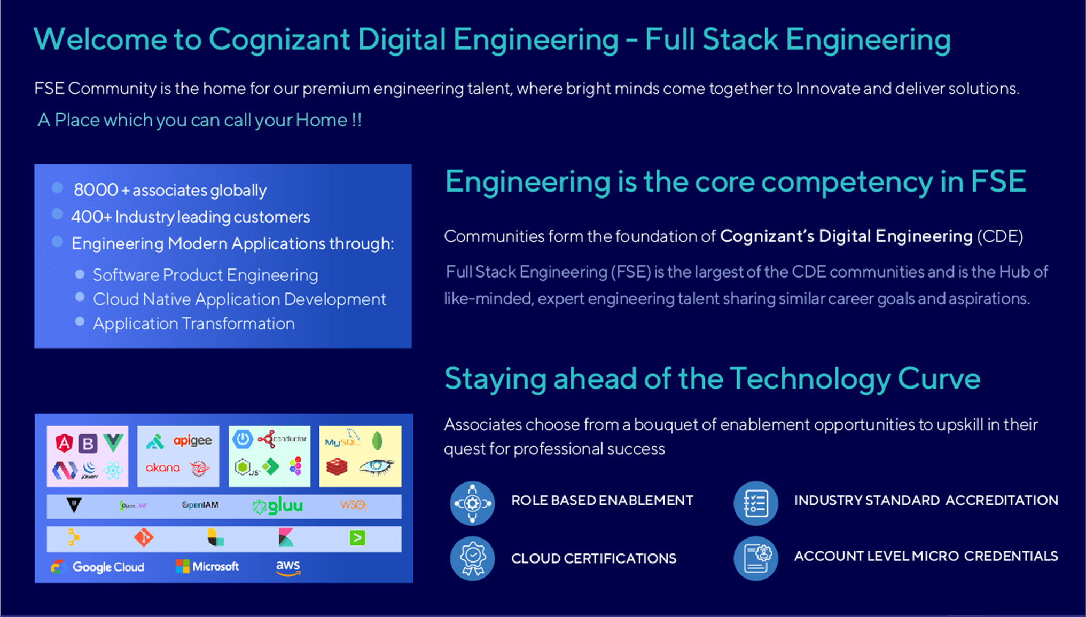

Slide 9

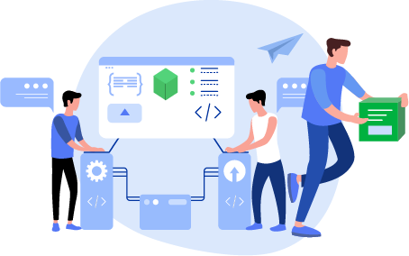

Our FSE Community Charter
“
To grow and nurture a diverse community of demonstrably superior engineering talent to help Cognizant deliver high quality engineering outcomes and enhance the market positioning of our engineering capabilities
“

Slide 10
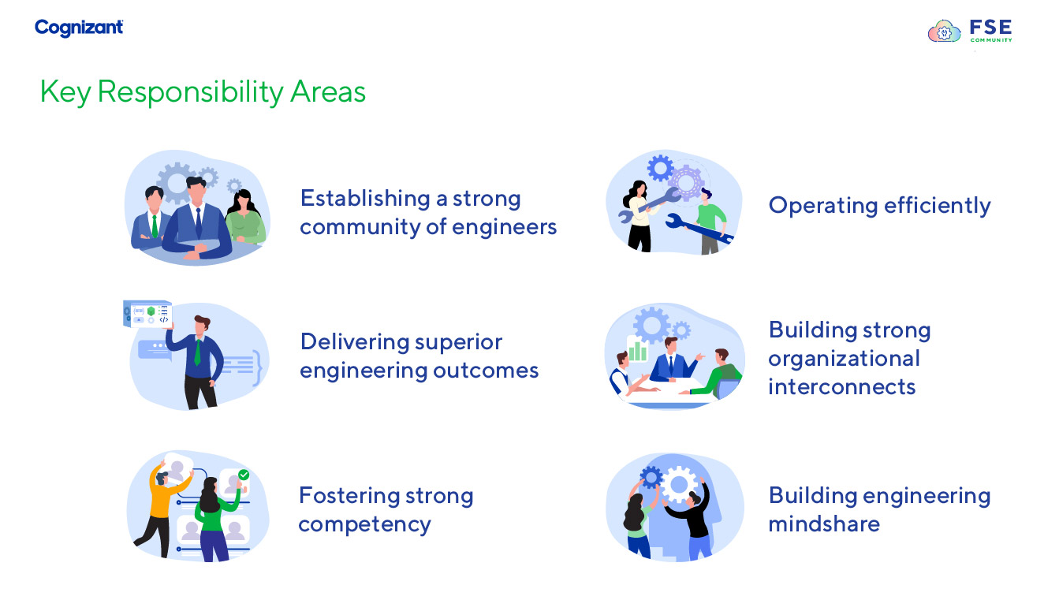

Slide 11
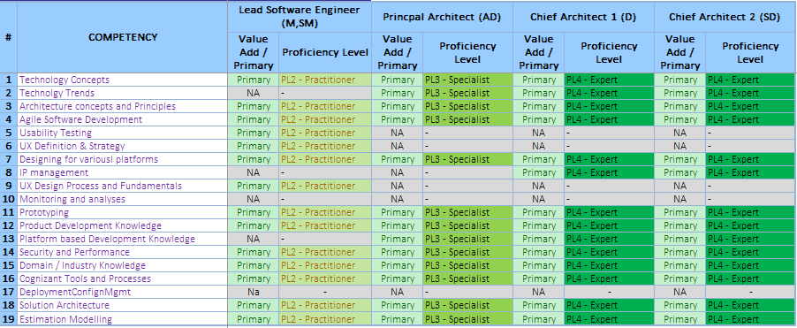
FSE Canonical Model
FSE Canonical Model
FSE Canonical Model forms the basis of role-based enablement needs, hiring, role fitment and enables career planning for associates and objective career guidance for managers
FSE Roles
FSE Competencies
Skill Depth
SD
Distinguished SE
Engineering
Programming Languages
D
Chief SE
Operations
Products & Frameworks
AD
Principal SE
Expert (4)
SM
Lead SE
Strategy
Platforms
M
Sr. SE
B3
Relationship Management
Specialist (3)
SA
B2
People Management
Architecture Building Blocks
Practitioner (2)
A
SE
Project Management
Engineering Quality
Learner (1)
P / PA
Jr. SE
PAT / PT
SE Trainee
Marketing
Engineering Mindset
Notes:
These are the roles in FSE community and as you are all aware that we have a canonical model aligned to all the roles.
Role based programs is a transformational journey with a well-distributed in-depth specialization across the 7 competency areas. It provides a capability to work through all phases of the product development and forms the basis of role fitment and enables career planning for associates and objective career guidance for managers.
Engineering forms the core competency of the FSE and is further broken down into 6 competencies - Programming Languages, Products & Frameworks, Platforms, Architecture Building Blocks, Engineering Quality, Engineering Mindset. Each of these competencies have certain set of skills at a prescribed skill depth as per Dreyfus scale.
To know more about the canonical model, you can refer to Be.Cognizant FSE Community page. We have a suite of Role based programs that are in alignment with this canonical model approach and we will walk you through the programs in the upcoming slides.

Slide 12
FSE Community CCA provides a clear career path for engineers
High-end, aspirational engineering roles
Demonstrates organizational Commitment towards engineering career growth
Creates Engineering capability depth
Micro-banding
Recognize capability/proficiency growth within a role
Have a role span multiple designation bands
Give more freedom to perform the same role across designation
Capability based grooming and structured assistance in moving across the career lattice
Provide talent base
Capability based nurturing

Slide 13
Career Architecture: Basis of all people practices
+
+
Talent intake
Goal Setting & Performance management
Hiring based on Competency model and Role expectations
Standardized multiple stage interview process
Transparent and objective process
Graded to role responsibility and expectation
Talent Profiling
Role fitment to engagement expectations
Profiling current talent and shifting the profile to changing demand
Matching role to project expectations / demand
Learning Objectives
Role based enablement and accreditation
Helps attain delta skills required to perform to engagement expectations
Enabling Roles for the competency expectations
Multi-stage accreditation validates role competency

Slide 14
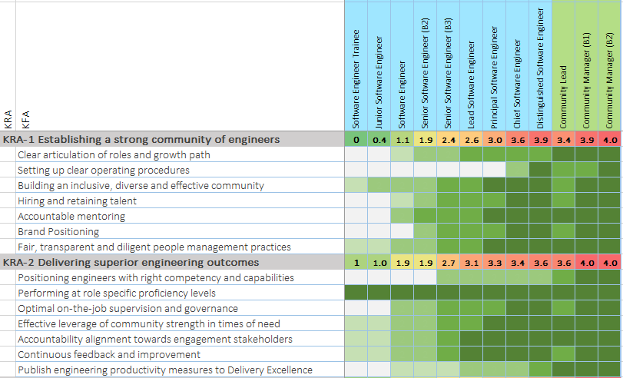
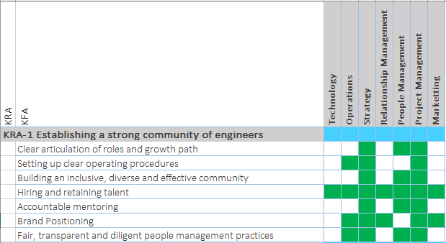
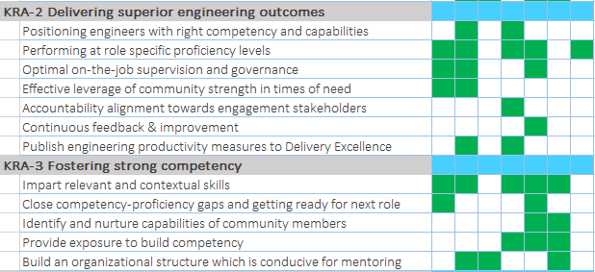
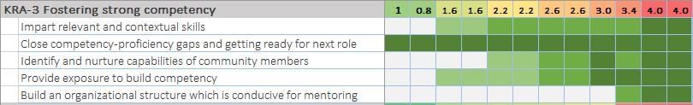
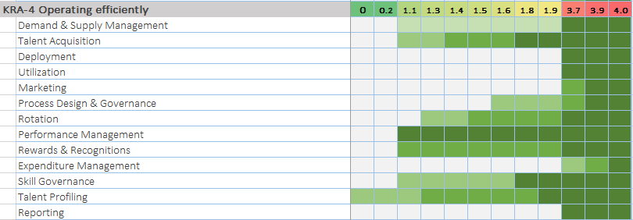
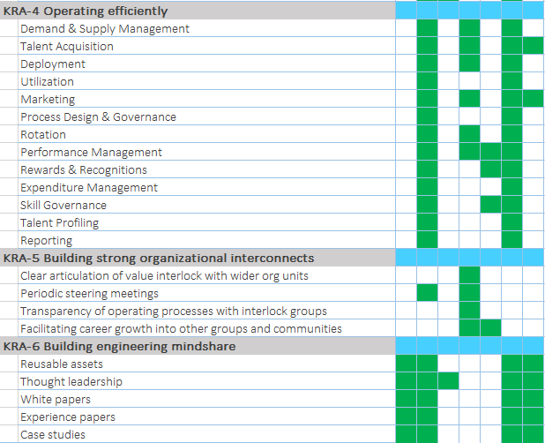
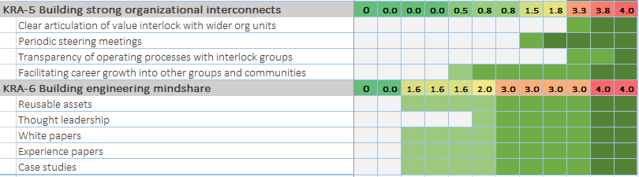
Competencies identified help set expectations for a Role
Engineering
Operations
Strategy
Relationship Management
People Management
Project Management
Marketing
1
2
3
4
Starting from the set of six key responsibility areas, a set of focus areas are defined for each
Responsibilities and accountabilities of the focus areas are landscaped across the career lattice to arrive at the role-responsibility descriptions
A set of competency buckets are identified which will help deliver the community responsibilities
Seven competency buckets are identified, which will be further elaborated in terms of proficiency levels and spread across the roles in accordance with the role responsibilities

Slide 15



Competency gradation by role
Each role is mapped to 12 (Twelve) competency areas which defines the proficiency levels required for each role
Expert
Specialist
Practitioner
INDICATIVE
Learner
Proficiency expectations for each competency is articulated as per Dreyfus scale
This forms the basis of role based enablement needs, hiring, role fitment and enables career planning for associates and objective career guidance for managers

Slide 16
Engineering is the key FSE competency
Engineering is the single most important competency of the FSE community
Engineering
Programming Languages
Products & Frameworks
Platforms
Operations
Engineering Concepts
Strategy
Relationship Management
People Management
Engineering Quality
Project Management
Marketing
Engineering Mindset

Slide 17
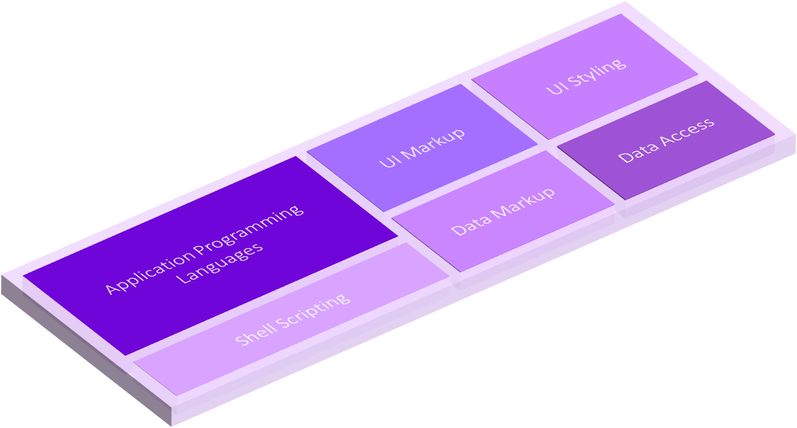
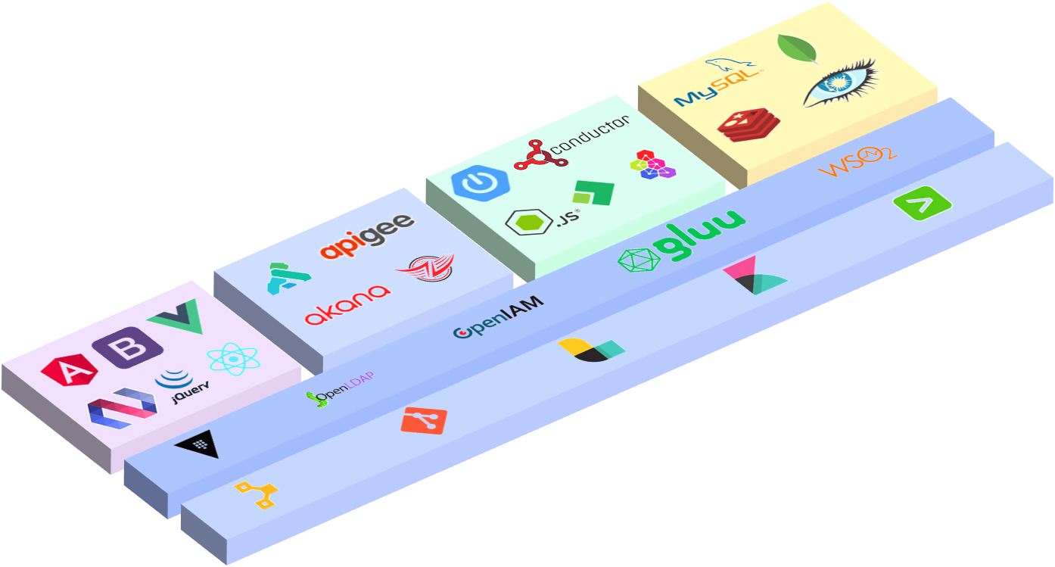
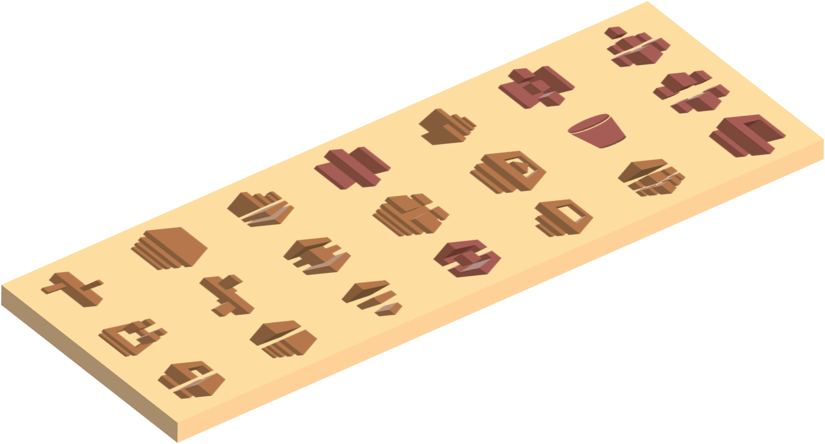
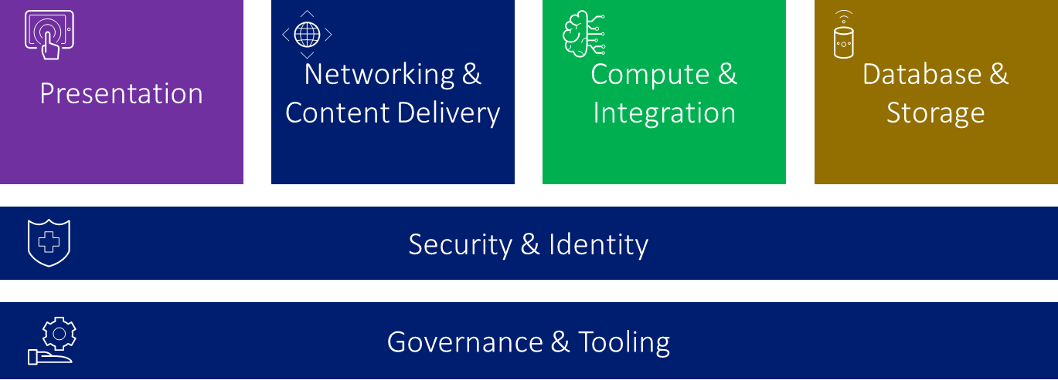
Key layers of Engineering Competencies
Programming Languages
Working proficiency in programming languages.
Language syntax, features, libraries and implementation design patterns.
Products & Frameworks
Working experience on one or more products/frameworks at each architectural tier.
Feature set, best practices, performance considerations etc.
Platforms
Working experience on a subset of cloud managed services.
APIs, Debugging, troubleshooting and engineering best practices of working with cloud managed services.
Engineering Concepts
Conceptual clarity of engineering aspects in architectural tiers. e.g.
Difference between document database and object database
Importance of port mapping in containers

Slide 18
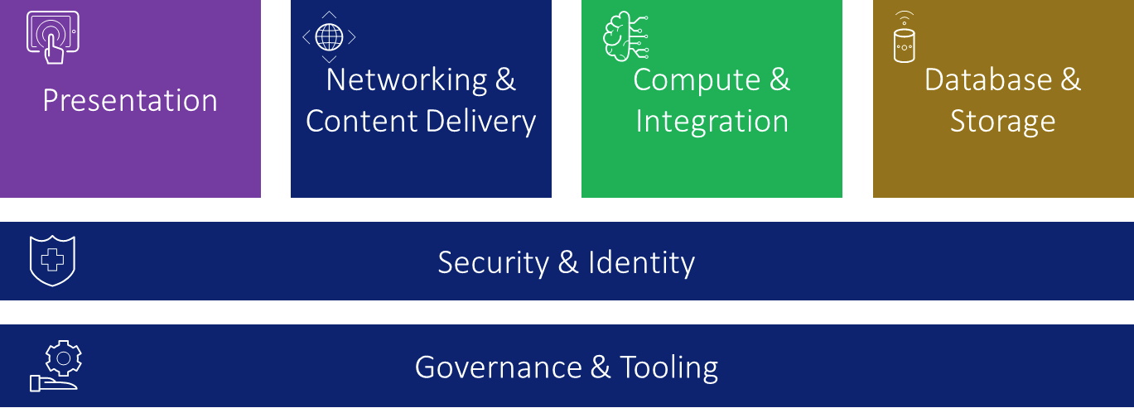
Key layers of Engineering Competencies
Engineering Quality
Working proficiency in sizing work units, developing secure, testable and quality code
Code Quality, Unit & Integration testing, Secure Coding and Estimation
Engineering Mindset
Proficiency in ways of working, DevOps and consulting approaches
Agile/Scrum, POD based Delivery, TDD/BDD etc.

Slide 19




FSE Agenda for Success
Provide a nurturing workplace - Engaging, Collaborative, Responsive, Safe, Unbiased, Celebrating Excellence
1
People
P
2
Skilling
Skilling to enable Best-in-class Delivery : Well-rounded, battle-ready Engineers.
FSE Community
Agenda 2022
3
Growth
Grow to exceed targets, thru active involvement with Talent market and effective talent selection
4
Delivery Engagement
Help deliver better engineering outcomes through Tech Governance, Best practices etc
5
Market Presence
Establish a strong brand presence amongst customers, Analysts, Associates and other stakeholders
Building Blocks
Community Managers
Home Managers
Chapter Leads
Leadership Squads

Slide 20
FSE Enablement

Slide 21




Mastery of the Craft
Staying Ahead of the evolving Technology landscape
With a Career Architecture defined with competency expectations for every level, associates can choose from a bouquet of enablement opportunities to upskill oneself in their quest for professional success
(A^2 M)
Campus Hires
Role Based
Accreditation
Cloud Certification
Client Specific Skilling
Enables campus grads acquire skills and get ready for customer engagements
Help associates acquire skills aligned to Role Competency - Proficiency expectations
Enablement to support industry standard certification for hyper scalers
Need specific, on-demand skilling to align associates with an account- specific technology needs
Pre-Hire Training Program
Full Stack Accreditation for all roles
Cloud enablement & certification (AWS/Azure/GCP)
Micro-Credential Program
Accelerate Accreditation Model to drive learning towards Industry aligned Accreditations for all FSE Associates

Slide 22
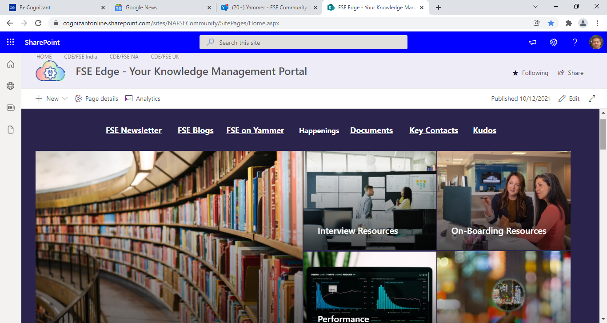
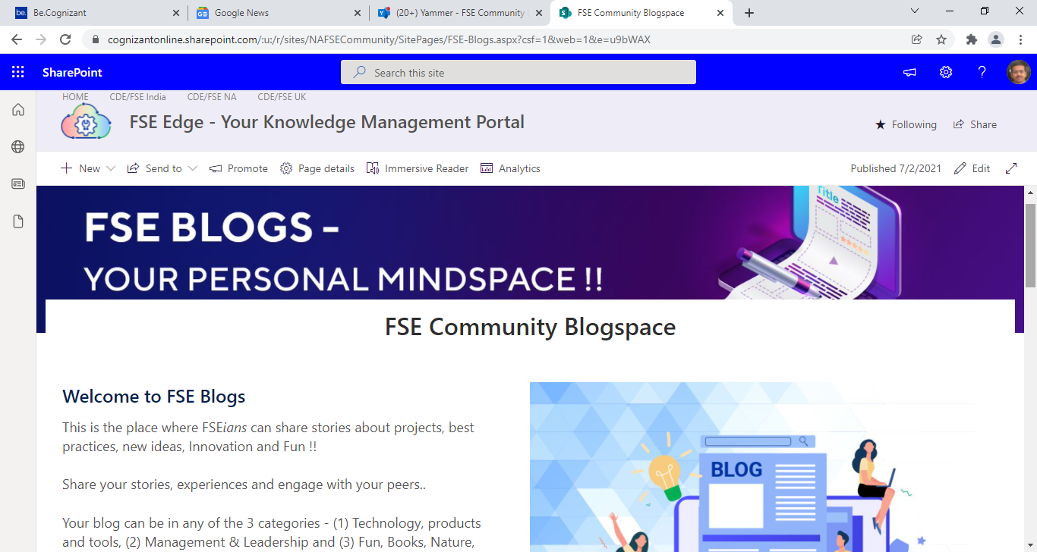
FSE Mindshare
FSE Blogs
Cross Platform development with .Net MAUI
Role based Access Control
Couchbase Concepts
Worker Service in .Net Core
Front Door In Azure in Wiki
FSE Mindshare in Be.Cognizant
https://be.cognizant.com/documents/preview/1022824/HackerRank-Journey-From-Disarray-to-Execution-Excellence
https://be.cognizant.com/documents/preview/873241/DynamoDB-Case-Study
https://be.cognizant.com/sites/cognizant-digital-business/News/992165/introduction-to-elasticsearch-white-paper
FSE Edge KM Portal

Slide 23
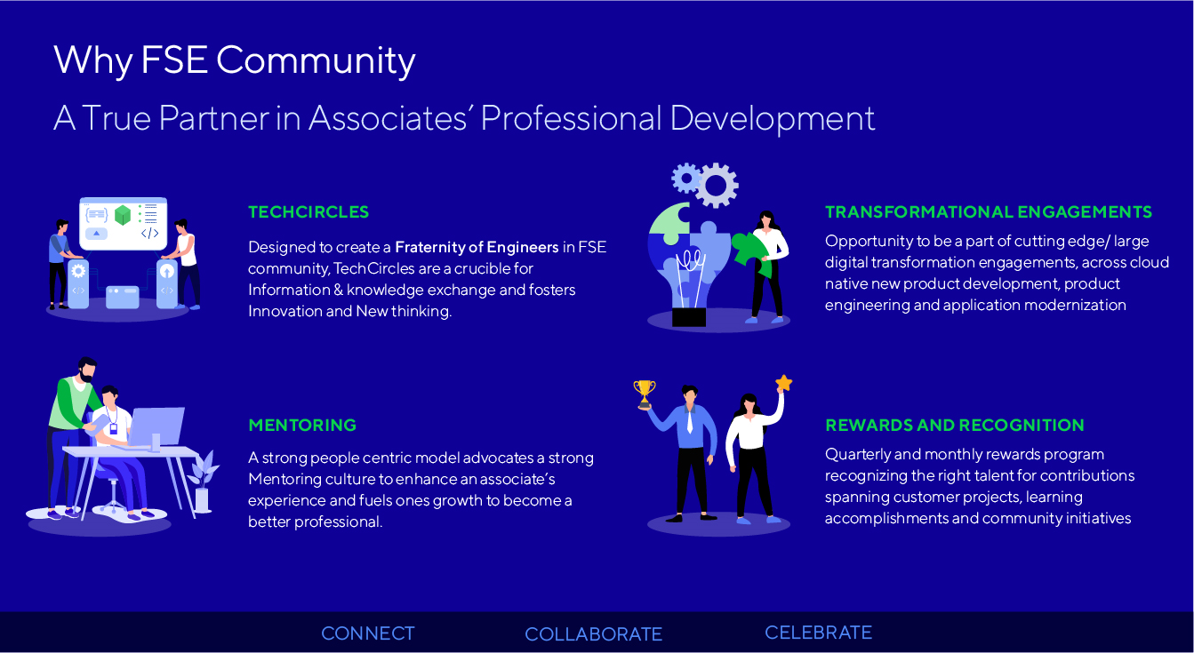

Slide 24
Thank You

